Slide 1
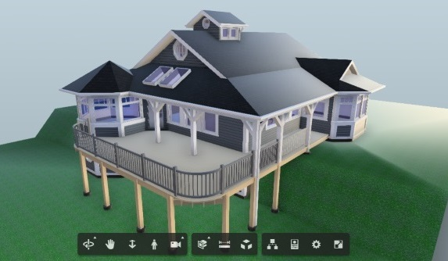
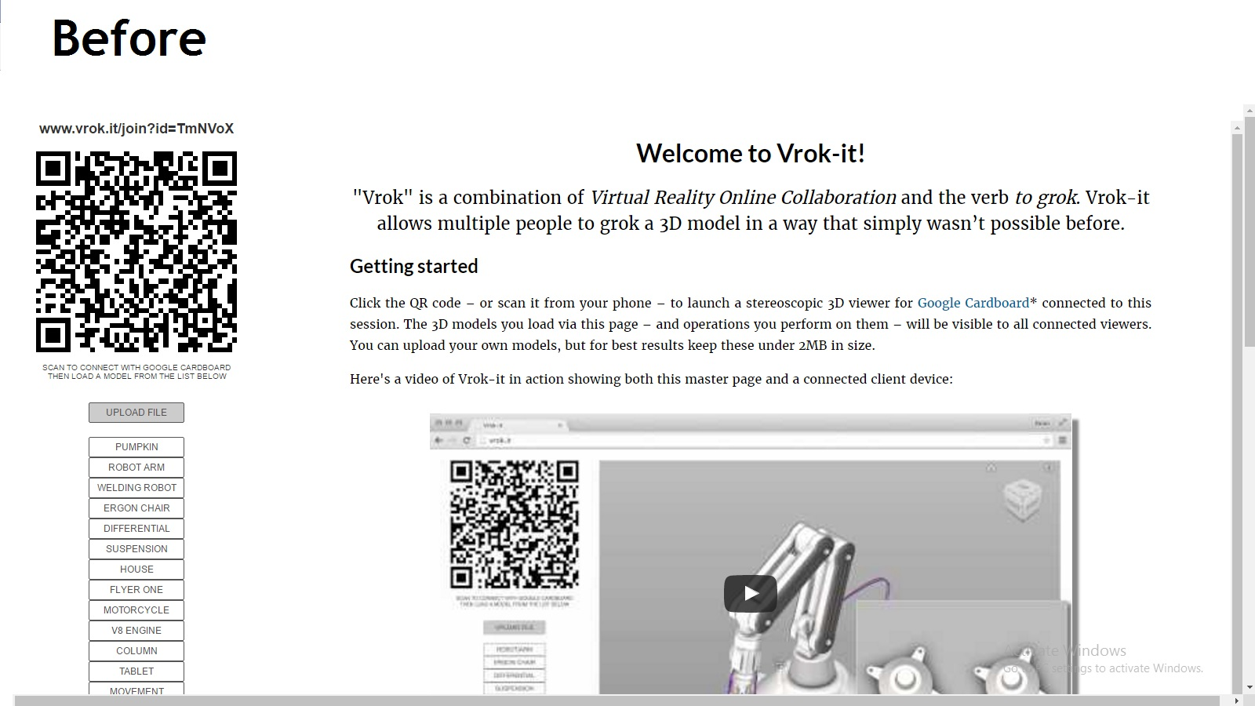
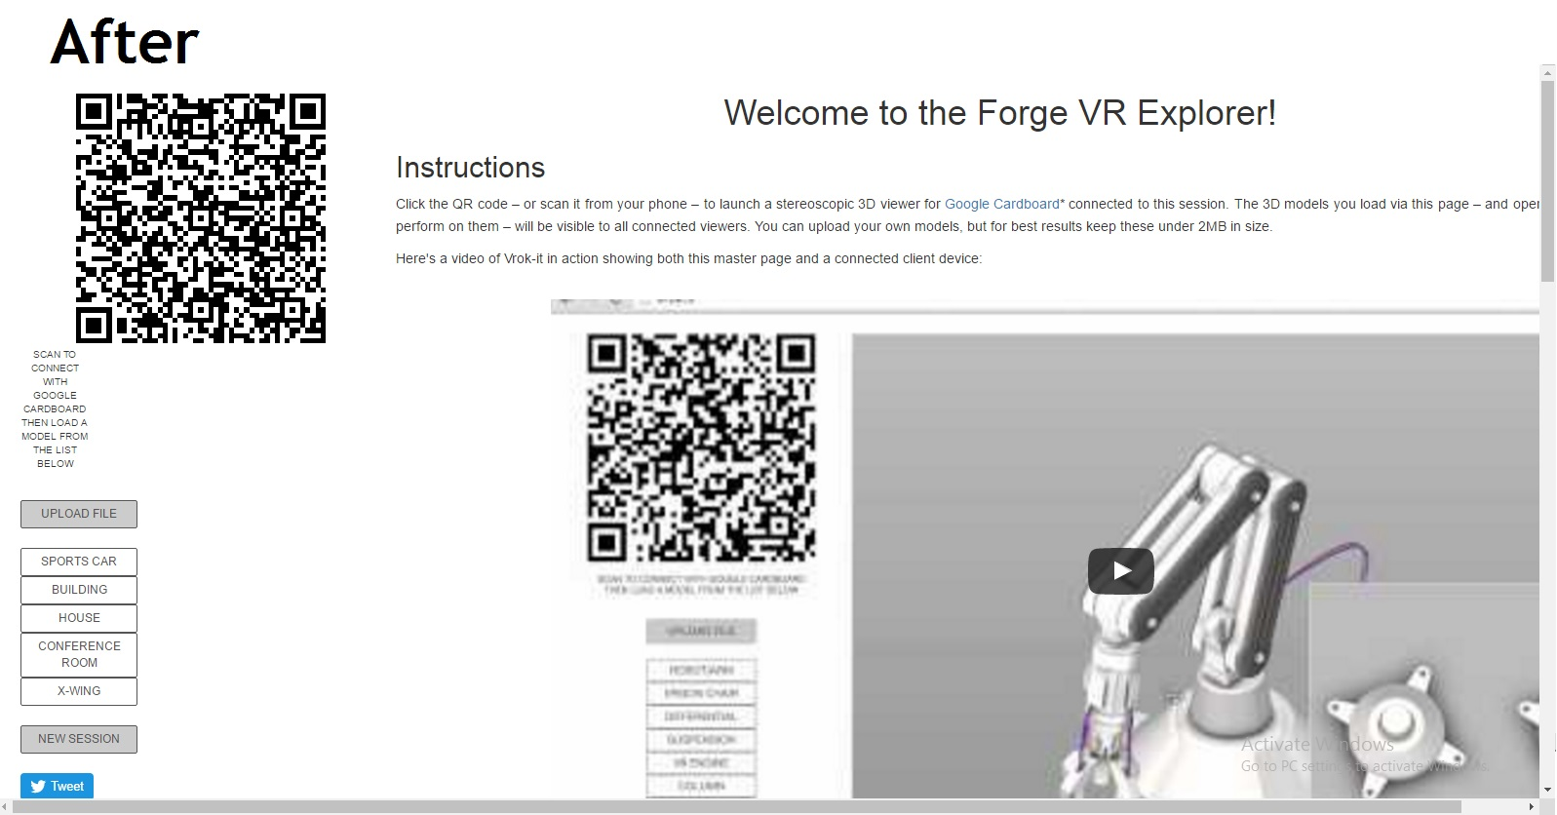
Forge virtual reality explorer
Introduction and Background
Team Bios
3 Dimensional Model Viewer on the Web with Autodesk’s Forge API
Background
Initially, our task was to build a project of our choosing using the Forge APIs. The freedom in being able to choose a project of our choice was a big motivator. After speaking with different Autodesk members, we decided to undertake an old hackathon project belonging to an employee named Kean. Kean had created a site he named Vrok.it. Vrok.it utilized the Large Model Viewer API for the viewing of 3D models and he added the ability to view them on a mobile device. However, as a hackathon project it was put together quickly and did not have all the features it should have. Our task became to improve the usability of the site while incorporating additional APIs into it.
Not sure yet
Results and Conclusion
What started as a hackathon project has become a fully functioning product that uses these APIs to provide the following features:
Data Authentication- A user is now able to log in if they have an Autodesk account.
Data Management- After logging in the user can now upload files from any of the cloud services
Model Derivative
Large Model Viewer- Updated and allows for keyboard keys to be pressed for movement as well as mouse movement
Allows for the upload of 3D files to the site. This process also prevents files of the incorrect type from being uploaded
Description
We took the website Vrok.it and improved its usability and added extra features into it using the Forge APIs. We changed the entire server system to use the APIs and then updated the face of the website to make it easier to use.
The Forge API Collection
Data Management
The Model Derivative API enables users to represent and share their designs in different formats, as well as to extract valuable metadata. (Its translation functionality was previously bundled as part of the “View and Data API”.) Translate designs into SVF format for extracting data and for rendering files in the viewer.
Data Authentication
OAuth, specifically OAuth2, is the open standard used across the Forge Platform for token-based authentication and authorization.
Model Derivative
The Data Management API provides a unified and consistent way to access data across BIM 360 Team, Fusion Team (formerly known as A360 Team), BIM 360 Docs, A360 Personal, and the Object Storage Service.
Large Model Viewer
The Viewer (formerly part of the “View and Data API”) is a WebGL-based, JavaScript library for 3D and 2D model rendering. 3D and 2D model data may come from a wide array of applications, such as AutoCAD, Fusion360, Revit, and many more.
Team Members
Paul Kwak. Computer Science Major
Shawn Cross. Computer Science Major
Griffin Gonsalves. Computer Science Major
Client: Autodesk’s Patti Vrobel
We are the Forge Virtual Reality Explorer group!
Notes:
If tri-fold mounting at SMS – make sure no text or image is in-between the two vertical guide lines; this space will be cut away. To view the vertical guide lines: Select “View” from the main menu, select “Guides” from the pull down menu, and lastly select “Static Guides”.

